Slide 1
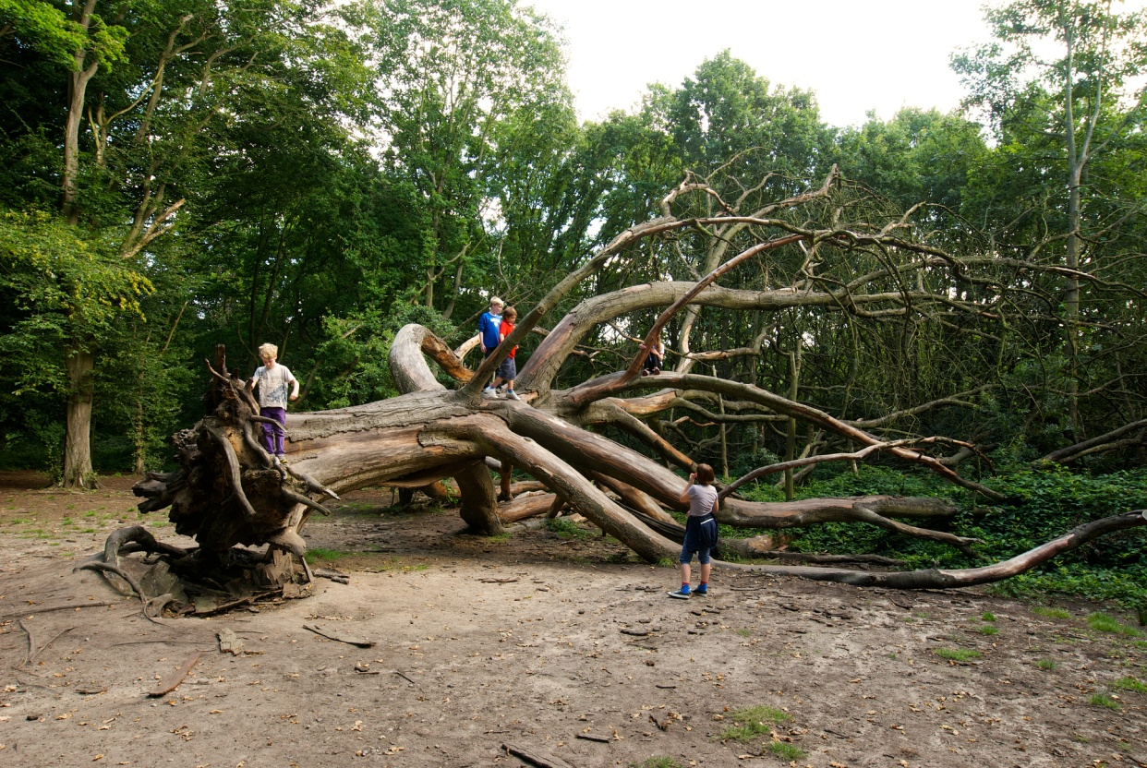
Legislation
Many different laws deal with trees
What you can/cannot do depends on the law and the situation

Slide 2
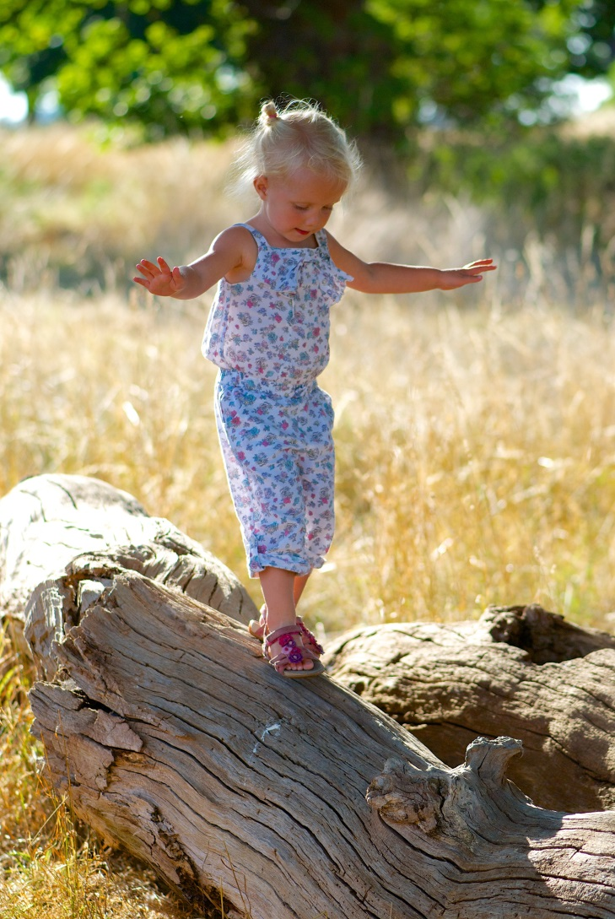
Protected areas/designations
TPO
Urban conservation area
SSSI
Natura 2000 (SAC/SPA)
Scheduled Ancient monument
National Park
Woodland
Protected species (especially bats)
Health and Safety
Photo: Brian Cleckner

Slide 3
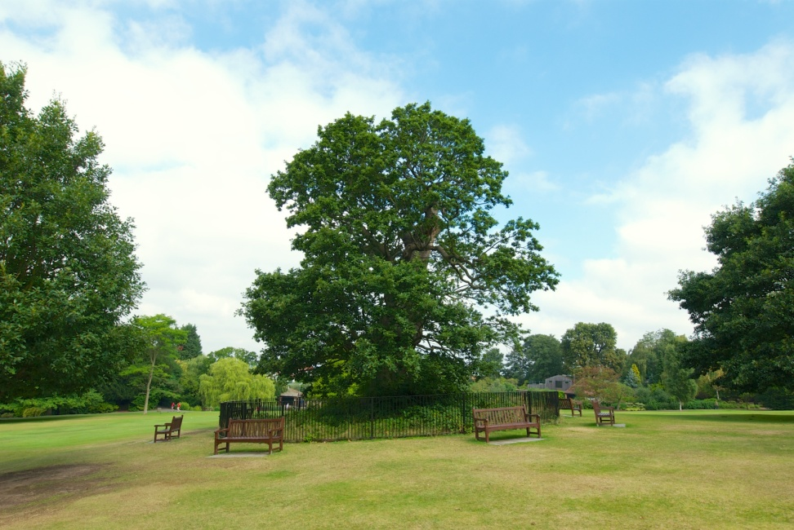
Tree Preservation Order (TPO)
Placed by local planning authority
An offence to cut down, top, lop, uproot, wilfully damage or destroy a tree
Permission can be granted for work
Exceptions include:
An urgent and serious safety risk (but must notify as soon as possible)
Tree is dead (but must give 5 days notice)
Pruning trees in an orchard
Prevent or control a legal nuisance
Removing dead branches from a tree
Unlimited fine if tree felled
£2,500 for other offences
Photo: Brian Cleckner

Slide 4
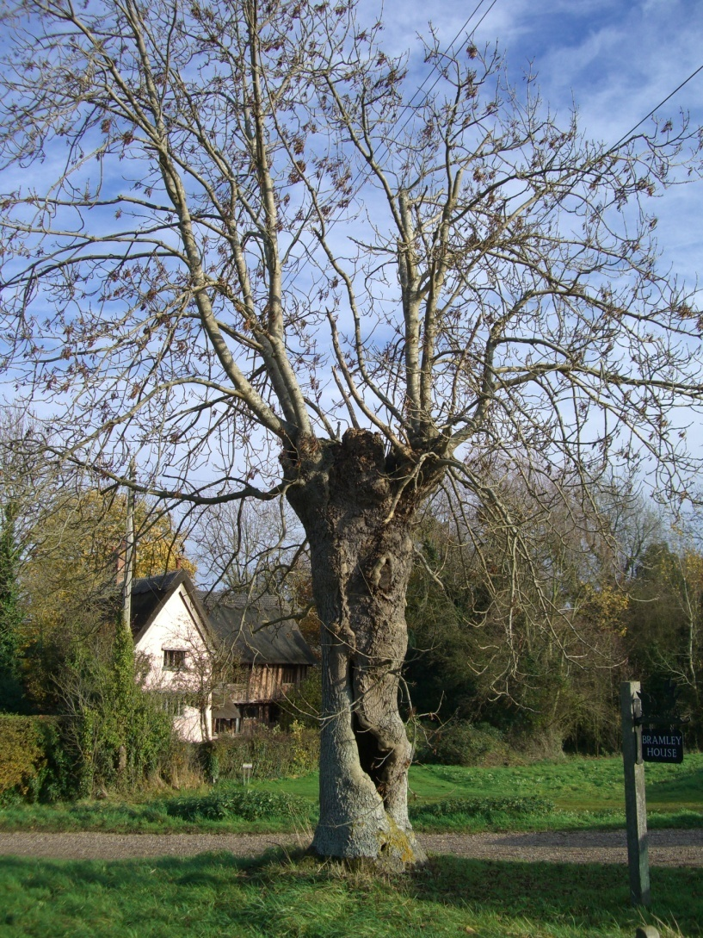
Conservation Areas
Trees may be covered by TPOs
if not, must give written notice of proposed work to LA at least 6 weeks before work starts
Tree = >7.5cm in diameter at 1.5m above ground
Photo: Helen Read
Notes:
Areas designated for their architectural or historic interest by Local Authority – the character and appearance of which it is desirable to preserve and enhance

Slide 5
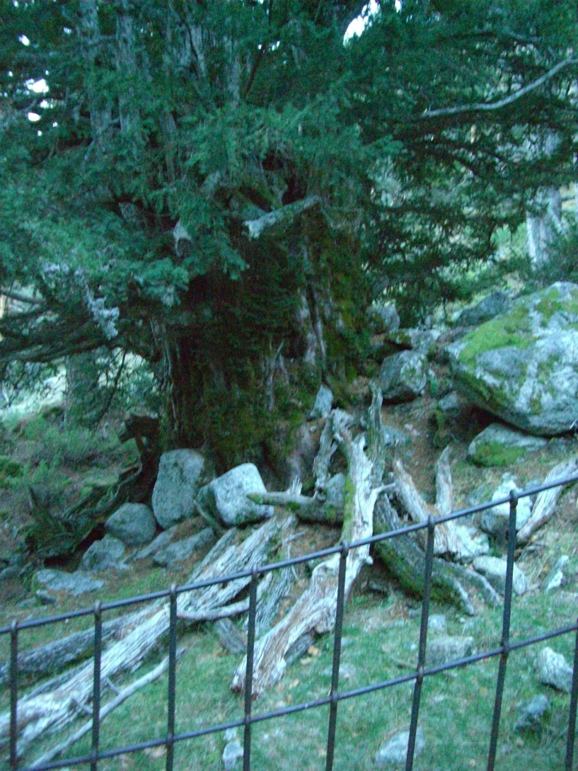
Churches
Trees may have TPO or be within an urban conservation area
Also need to consult the diocese
Photo: Helen Read

Slide 6
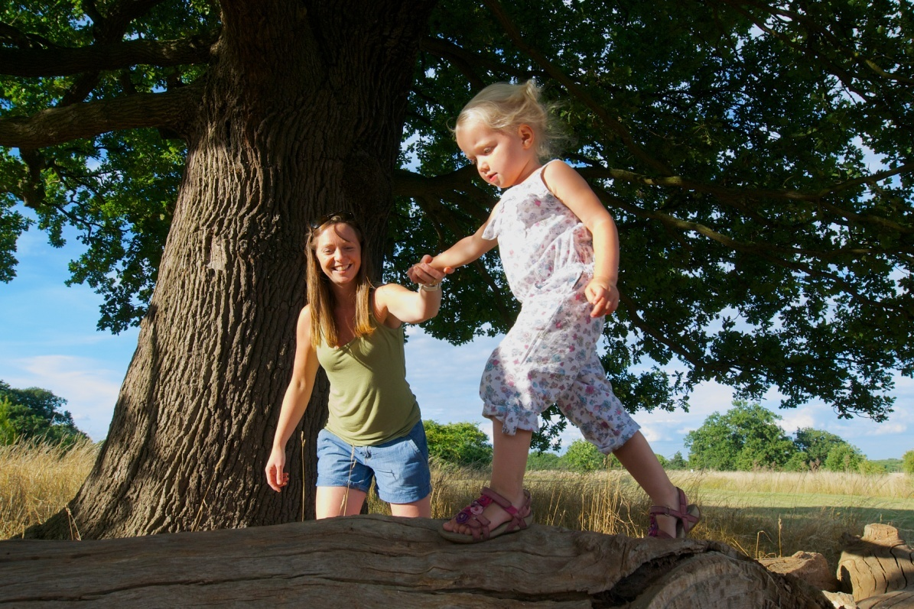
Occupier’s Liability Acts 1957 & 1984
Duty of care for ’visitors’
Occupier (owner, tennant etc.) may be liable for harm or injury if a tree of part of it fails
Must take ’reasonable care’ to avoid acts which could reasonably be seen to result in injury or harm
Photo: Brian Cleckner
Notes:
Visitors include invited or tresspassers
Different laws in Scotland and Northern Ireland

Slide 7
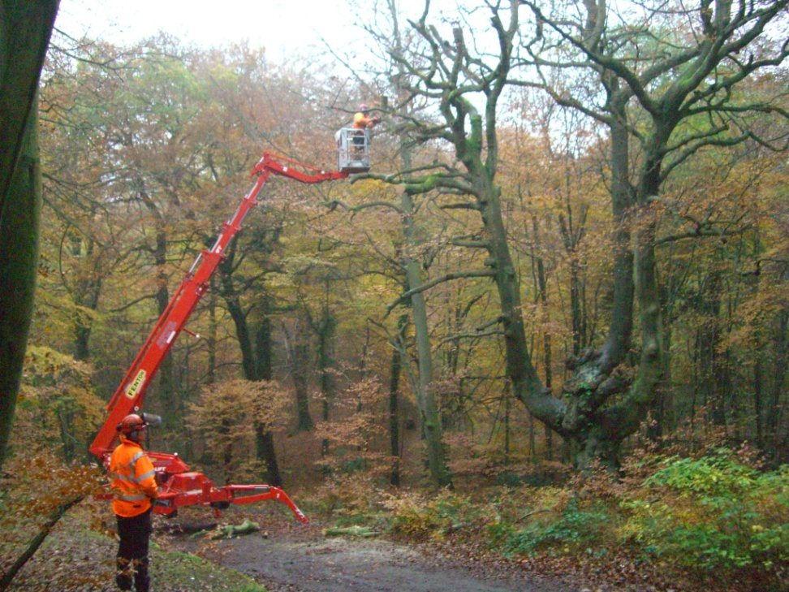
Health & Safety at Work Acts
1974 & 1999
Employers to ensure (as far as reasonably practicable) employees and members of public are not put at risk
To make suitable and sufficient assessment of risks (to those not employed) arising out of or in connection with the undertaking of the work
Photo: Helen Read
Notes:
This second one means undertaking risk assessment of the tree stock

Slide 8
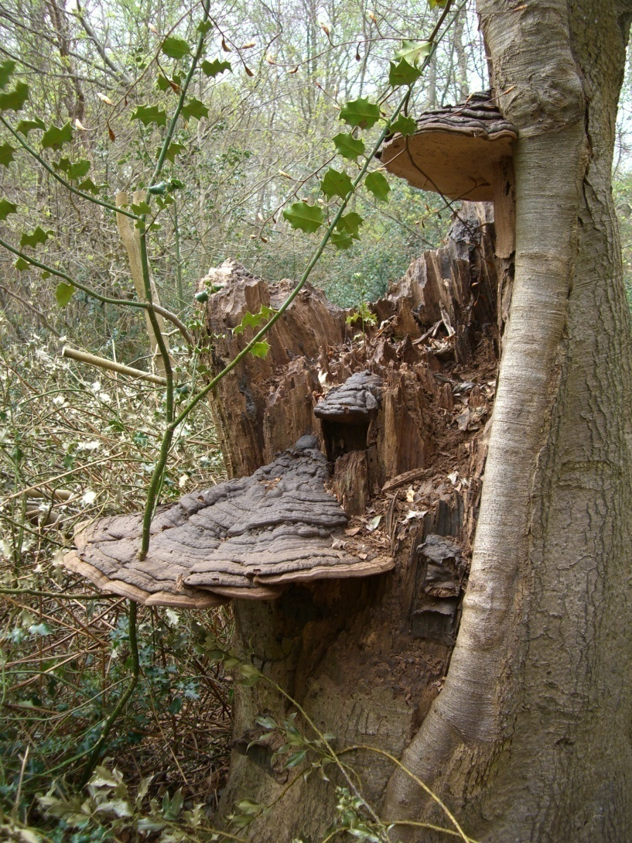
Protected areas
Protection depends on on the designation of the area
SSSI have Potentially Damanging Operations (PDOs) check to see what activities require consent
European protected sites (e.g. SAC) are all SSSI as well
Photo: Helen Read

Slide 9
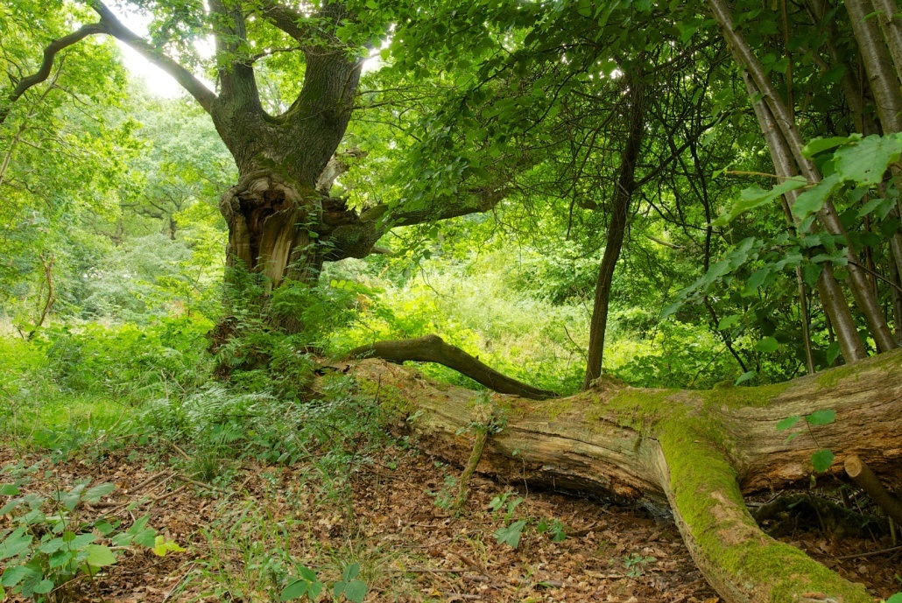
Scheduled Ancient Monuments
Talk to English Heritage & local authority archaeologist
Management to trees on SAMs can be fully compatible with that of the monument (reducing canopies to prevent trees failing)
Important not to disturb the ground
Photo: Brian Cleckner

Slide 10
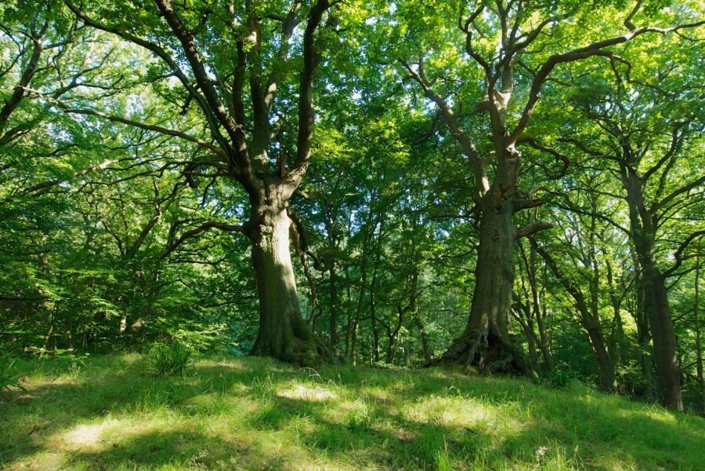
Protection for woodland trees
Felling licences
Required for felling more than 5 cubic metres in any calendar quarter (from Forestry Commission)
UKWAS (FSC)
Requirement to provide diversity of deadwood including standing dead & veteran trees
Plan for future veteran trees
Photo: Brian Cleckner
Notes:
Felling licence: A licence is not needed for felling less as long as no more than two cubic metres are sold (five cubic metres is roughly equivalent to one large oak tree or 50 thin chestnut coppice trees).
Allow up to three months for processing.
UKWAS UK Woodland Assurance Standard – visible to consumers as FSC certificate.
Approximately 50% of the UK woodlands are covered.
Obligation to provide a diversity of standing and fallen deadwood habitats, accumulate deadwood volumes and maintain veteran trees. Also to manage suitable trees to take the place of existing veterans.

Slide 11
Protected species
Wildlife & Countryside Act 1981 & Countryside & Rights of Way Act 2000 & Natural Environment & Rural Comminities Act 2006
Animals:
  Forbidden to kill, injure, take or sell animals listed on schedule.
  For some (bats) this includes damaging or destroying places of shelter
Birds:
  Prohibited to kill injure or take wild birds or their nests
  Level of protection varies per species
Injured birds/animals:
  Can be taken if ’disabled’ with intention of tending to is
Plants:
  Forbidden to pick, uproot, destroy or sell plants on schedule
  Also all plants unless done by owner/occupier

Slide 12
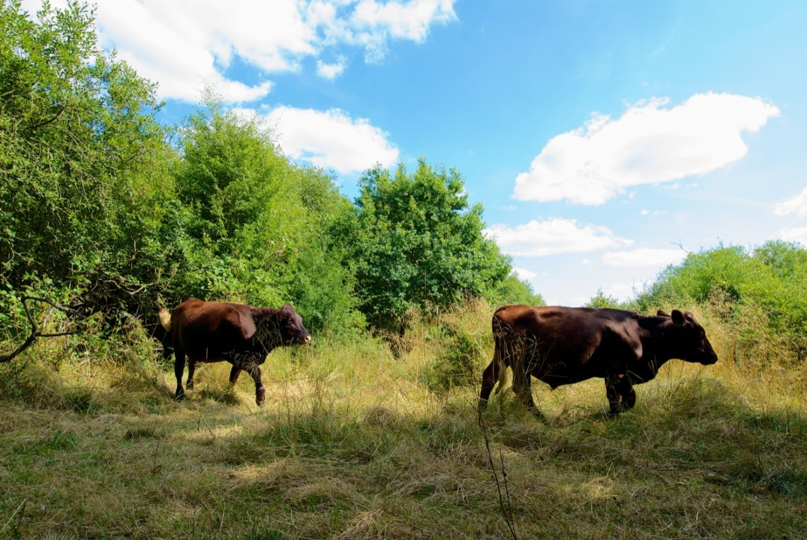
Grants
Agri Environment schemes : Basic payment scheme
Farmers will be required to deduct tree canopy area
More than 100 trees per had the parcel will be ineligible (except fruit trees)
Photo: Brian Cleckner
Notes:
Not helpful for veteran trees!

Slide 13
Grants
Agri Environment schemes : Countryside Stewardship
In-field trees (190-£420/ha)
Wood pasture management/restoration/creation (£46-£409/ha)
Veteran tree surgery (£221/tree)
Planting parkland trees (£24.5/tree)
Tree guards (£4-£170/tree)
Creation of dead wood habitats (£175/unit)
Management of traditional orchards (£212/ha)
Notes:
Examples and not exhaustive!

